Slide 1

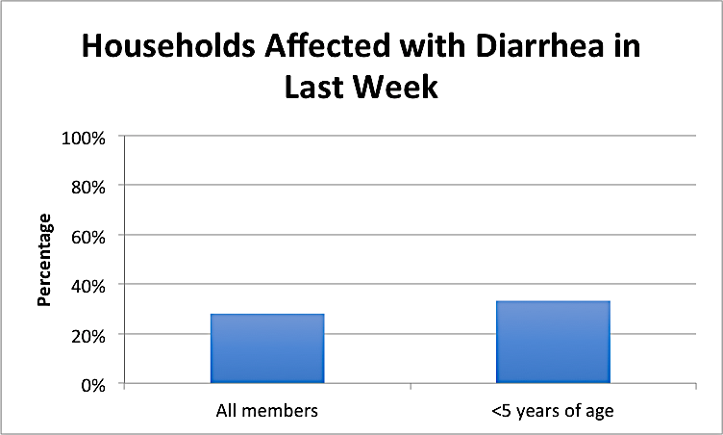
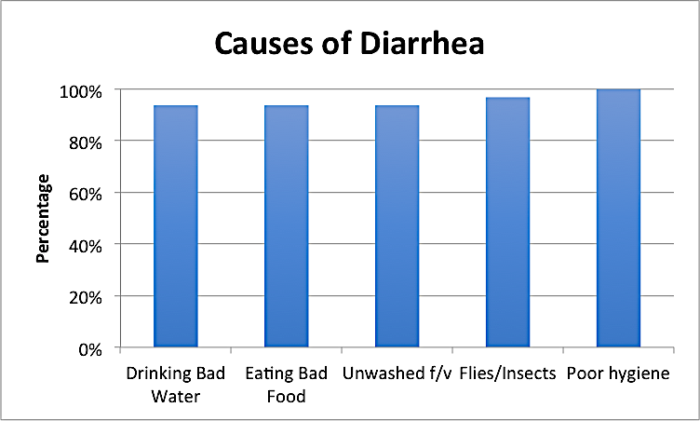
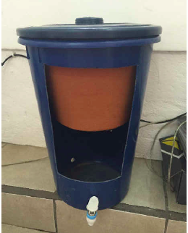
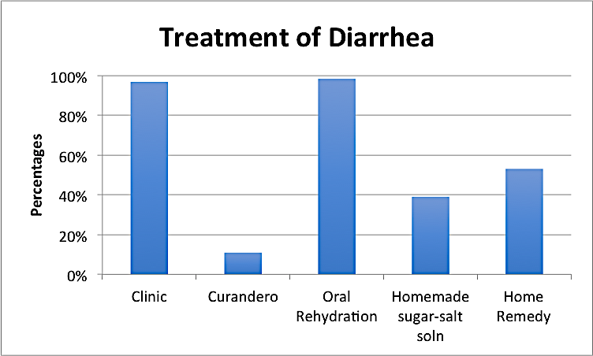
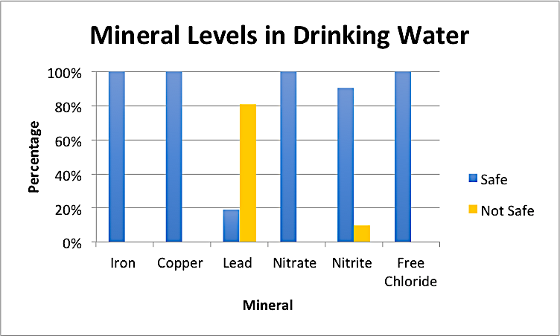
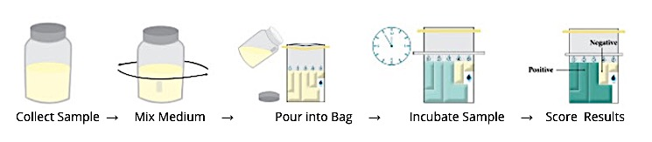
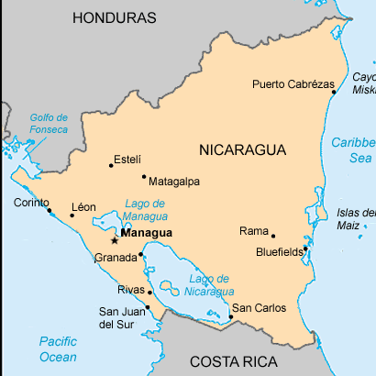
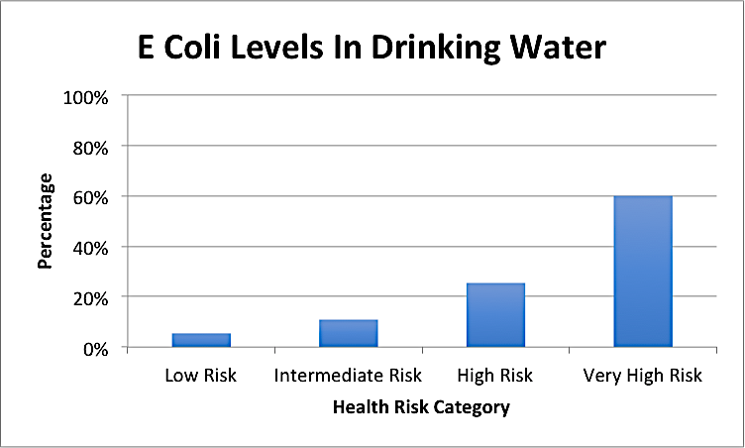
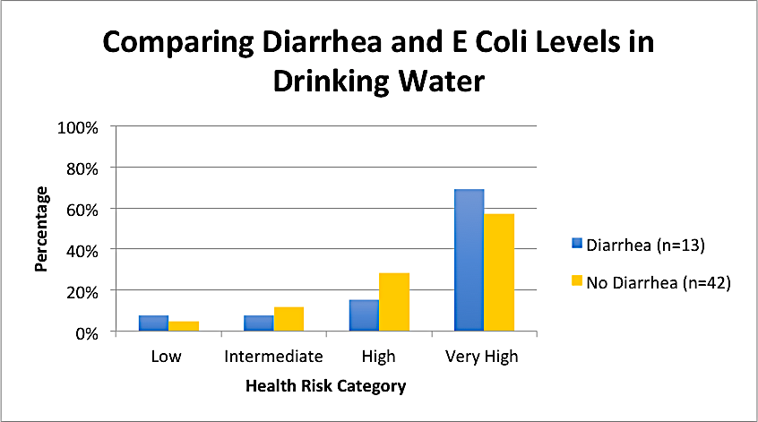
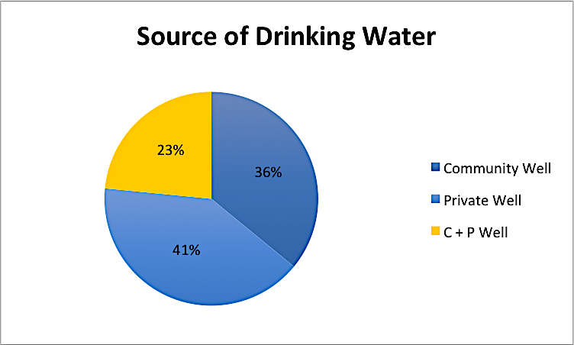
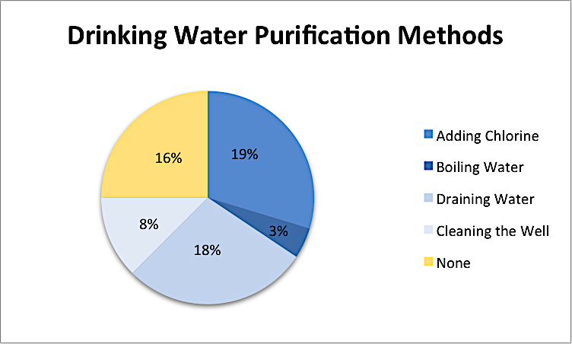
Point of Use Water Purification Technology (POuWT) To Increase Access to Drinking Water in Rural Nicaragua
Daniel O. Hernandez¹, Nancy Rivera, MS¹, David J. Copenhaver, MD¹
¹University of California, Davis School of Medicine, Sacramento, CA, USA
Background & Aims
According to WHO, endemic diarrheal disease is a leading cause of mortality, morbidity and malnutrition, especially in children under the age of five [1]. It is a result of a lack of access to clean water and living conditions that do not promote personal and domestic hygiene.
Hypothesis
Baseline diarrheal disease rates will be inversely related to access to clean drinking water.
Introducing POuWT to households in rural Nicaragua will improve the quality of drinking water by reducing the amount of bacteria and contaminants.
Methods
  Survey Design
A demographic survey and a questionnaire on diarrhea, hygiene and sanitation practices was developed and translated into Spanish. The surveys were administered verbally in Spanish.
Data Collection
In collaboration with Dr. Marvin Salgado, households (n=70) were identified to receive Filtron ceramic filters. The filters are coated with safe levels of colloidal silver to treat contaminated water and are supported by numerous studies [3].
  Subject Demographics
Results and Discussion
Prior research on Point of Use Water Purification Technology (POuWT) has demonstrated 100% reduction of E. Coli bacteria, making it a safe and cost effective means of improving water quality in access-limited areas (Figure 1) [2].
Only 12% of the population living in rural Nicaragua have access to potable water. The lack of access to clean water makes Nicaragua susceptible to high rates of morbidity and mortality in children, especially those under the age of five.
Quantification Methods (Figure 3):
  JNW Test Strips (JNW)- assess for contaminants including lead, iron, copper, and free chlorine [4].
  Compartment Bag Tests (CBT)- generate quantified, color-change test results for the presence of E. coli [5].
Figure 8- 28% of households were affected with diarrhea in the last week, with 33% of those cases, affecting those <5 years of age.
Figure 9- Current knowledge of what causes diarrhea.
Day 0
24 hours later
Provide water filters to households and collect water sample n=70
JNW test strip screening n=70
CBT testing n=50
F/u CBT testing
results
Figure 1- Filtron is a low-cost household ceramic POuWT,
Figure 3: CBT Assay Methods.
Figure 4: Timeline of Bacterial and Contaminant Quantification.
Figure 10- Of different treatments, visiting a clinic and drinking oral rehydration drinks were most common.
Figure 11- Unsafe levels of lead and nitrites were detected in the drinking water.
La Paz Centro is a rural city in Nicaragua that has limited access to potable water (Figure 2).
Community members of La Paz Centro relies directly on surface water from rivers and wells, as their main source of water.
Enrolled (n=64)
Chacaras
(n=13)
Finca De Los Ramirez (n=5)
El Coco
(n=2)
El Chorizo (n=14)
El Venado (n=4)
Union (n=26)
Mean Age (years) | 40.3 +/- 14.6
Mean Household Size (# people) | 4.3 +/- 1.5
Households with children <5 years | 30
Access to Electricity (%) | 97
Less than Elementary School Educated (%) | 90
La Paz Centro
Figure 12: E coli levels ranges: 0/100mL= Low, 1-10/100mL = Intermediate, 11-100/100mL= High, >100/100mL= Very High.
Figure 13: In those who had diarrhea, 60% of households were drinking “very high risk” water.
Figure 2- Map of La Paz Centro, Nicaragua.
Figure 5: Enrollment of Households by Village.
Table 1: Characteristics of households that received Filtron ceramic filters.
Households visited in rural Nicaragua did not have access to potable water.
High rates of diarrhea as well as lead, nitrites, and E coli were detected in the drinking water.
A significant need for increasing access to potable water is suggested.
POuWT may play a role in bridging the barrier to potable water.
Results
References
Diarrhoeal disease Fact Sheet. WHO. 2013, http://www.who.int/mediacentre/factsheets/fs330/en/
Ehdaie B, Rento CT , Son V, Turner SS, Samie A, Dillingham RA, Smith JA. Evaluation of a Silver-Embedded Ceramic Tablet as a Primary and Secondary POuWT in Limpopo Province, S. Africa. PLoS ONE. Jan 17, 2017
Lantagne DS. Investigation of the Potters for Peace Colloidal Silver Impregnated Ceramic Filter, Report 1: Intrinsic Effectiveness. Jubilee House Community. December 21, 2001.
Searles N.S, Mueller B.A, Kuehn CM. An evaluation of semi-quantitative test strips for the measurement of nitrate in drinking water in epidemiologic studies. Journal of Exposure Science and Enviromental Epidemiology. March 2008
Weiss, P., Gim Aw, T., Urquhart, G. R., Galeano, M., Rose, J. Well water quality in rural Nicaragua using a low-cost bacterial test and microbial source tracking. Journal of Water/Health. April 2016.
Acknowledgements
Funding provided by UC Davis Blum Center (PASS) grant and Medical Student Research Fellowship
Figure 6: 100% of households obtained their drinking water from wells.
Figure 7- The majority of households (75%) treated their water.

